Slide 1
Artificial Intelligence (AI)

Slide 2
What is Artificial Intelligence (AI)?
In today's world, technology is growing very fast, and we are getting in touch with different new technologies day by day.
Here, one of the booming technologies of computer science is Artificial Intelligence which is ready to create a new revolution in the world by making intelligent machines.
The Artificial Intelligence is now all around us.
It is currently working with a variety of subfields, ranging from general to specific, such as self-driving cars, playing chess, proving theorems, playing music, Painting, etc.
AI is one of the fascinating and universal fields of Computer science which has a great scope in future. AI holds a tendency to cause a machine to work as a human.
Artificial Intelligence is composed of two words Artificial and Intelligence, where Artificial defines "man-made," and intelligence defines "thinking power", hence AI means "a man-made thinking power."

Slide 3
Artificial Intelligence exists when a machine can have human based skills such as learning, reasoning, and solving problems
With Artificial Intelligence you do not need to preprogram a machine to do some work, despite that you can create a machine with programmed algorithms which can work with own intelligence, and that is the awesomeness of AI.
It is believed that AI is not a new technology, and some people says that as per Greek myth, there were Mechanical men in early days which can work and behave like humans.

Slide 4
Why Artificial Intelligence?
Before Learning about Artificial Intelligence, we should know that what is the importance of AI and why should we learn it. Following are some main reasons to learn about AI:
With the help of AI, you can create such software or devices which can solve real-world problems very easily and with accuracy such as health issues, marketing, traffic issues, etc.
With the help of AI, you can create your personal virtual Assistant, such as Cortana, Google Assistant, Siri, etc.
With the help of AI, you can build such Robots which can work in an environment where survival of humans can be at risk.
AI opens a path for other new technologies, new devices, and new Opportunities.

Slide 5
Goals of Artificial Intelligence:
Following are the main goals of Artificial Intelligence:
Replicate human intelligence
Solve Knowledge-intensive tasks
An intelligent connection of perception and action
Building a machine which can perform tasks that requires human intelligence such as:
  Proving a theorem
  Playing chess
  Plan some surgical operation
  Driving a car in traffic
Creating some system which can exhibit intelligent behavior, learn new things by itself, demonstrate, explain, and can advise to its user.

Slide 6
What Comprises to Artificial Intelligence?
Artificial Intelligence is not just a part of computer science even it's so vast and requires lots of other factors which can contribute to it. To create the AI first we should know that how intelligence is composed, so the Intelligence is an intangible part of our brain which is a combination of Reasoning, learning, problem-solving perception, language understanding, etc.
To achieve the above factors for a machine or software Artificial Intelligence requires the following discipline:
  Mathematics
  Biology
  Psychology
  Sociology
  Computer Science
  Neurons Study
  Statistics

Slide 7
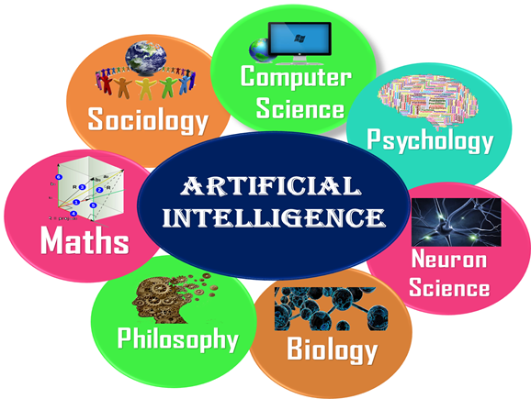

Slide 8
How does AI Works?
  Business problem understanding: A clear understanding of the problem statement is necessary to get the desired outcome. ask the client as many questions as possible. Gather relevant information. Focus on what changes the client expecting in the business from the conclusion of this project. Analyze risks and challenges.
  Data collection & Data Wrangling: Collect relevant data. The amount of data defines the model performance. So more data, the accurate the model is. Data Wrangling is preprocessing the data before feeding the model. Clean the noise data, identify missing values, outliers, skewness, etc. The perfect the data is, the better the outcome.
  Exploratory & Statistical analysis of Data: Explore the data derive insights and relations between the features. Eliminate the features that are less correlated or not correlated with the target feature. Perform statistical analysis to under the data better. This step is crucial to know the nature and hidden patterns of the data that helps to choose the model.
  Model building: The crucial step of the entire process is model building. Split the dataset into train and test data to train the model and check its performance on test data. Build the appropriate model according to the problem statement.
  Model evaluation: Validation is always necessary to obtain an accurate outcome. Evaluate the model’s performance using accuracy score, R2 score, classification report, etc. Improve the performance with respective methodologies if necessary.

Slide 9
Advantages of Artificial Intelligence:
Following are some main advantages of Artificial Intelligence:
High Accuracy with less errors: AI machines or systems are prone to less errors and high accuracy as it takes decisions as per pre-experience or information.
High-Speed: AI systems can be of very high-speed and fast-decision making, because of that AI systems can beat a chess champion in the Chess game.
High reliability: AI machines are highly reliable and can perform the same action multiple times with high accuracy.
Useful for risky areas: AI machines can be helpful in situations such as defusing a bomb, exploring the ocean floor, where to employ a human can be risky.
Digital Assistant: AI can be very useful to provide digital assistant to the users such as AI technology is currently used by various E-commerce websites to show the products as per customer requirement.
Useful as a public utility: AI can be very useful for public utilities such as a self-driving car which can make our journey safer and hassle-free, facial recognition for security purpose, Natural language processing to communicate with the human in human-language, etc.

Slide 10
Disadvantages of Artificial Intelligence:
Every technology has some disadvantages, and thesame goes for Artificial intelligence. Being so advantageous technology still, it has some disadvantages which we need to keep in our mind while creating an AI system.
Following are the disadvantages of AI:
High Cost: The hardware and software requirement of AI is very costly as it requires lots of maintenance to meet current world requirements.
Can't think out of the box: Even we are making smarter machines with AI, but still they cannot work out of the box, as the robot will only do that work for which they are trained, or programmed.
No feelings and emotions: AI machines can be an outstanding performer, but still it does not have the feeling so it cannot make any kind of emotional attachment with human, and may sometime be harmful for users if the proper care is not taken.
Increase dependency on machines: With the increment of technology, people are getting more dependent on devices and hence they are losing their mental capabilities.
No Original Creativity: As humans are so creative and can imagine some new ideas but still AI machines cannot beat this power of human intelligence and cannot be creative and imaginative.

Slide 11
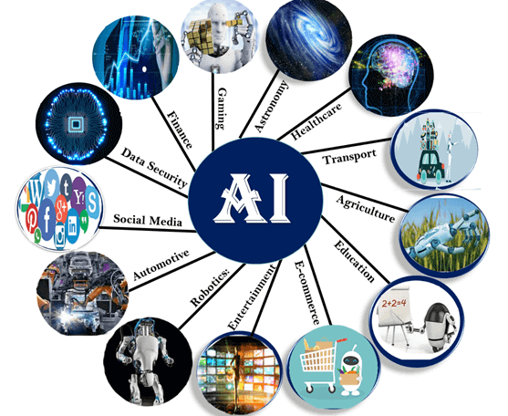
Application of AI:
Artificial Intelligence has various applications in today's society. It is becoming essential for today's time because it can solve complex problems with an efficient way in multiple industries, such as Healthcare, entertainment, finance, education, etc. AI is making our daily life more comfortable and fast.
Following are some sectors which have the application of Artificial Intelligence:

Slide 12
AI in Astronomy
Artificial Intelligence can be very useful to solve complex universe problems. AI technology can be helpful for understanding the universe such as how it works, origin, etc.
2. AI in Healthcare
In the last, five to ten years, AI becoming more advantageous for the healthcare industry and going to have a significant impact on this industry.
Healthcare Industries are applying AI to make a better and faster diagnosis than humans. AI can help doctors with diagnoses and can inform when patients are worsening so that medical help can reach to the patient before hospitalization.
3. AI in Gaming
AI can be used for gaming purpose. The AI machines can play strategic games like chess, where the machine needs to think of a large number of possible places.

Slide 13
4. AI in Finance:
AI and finance industries are the best matches for each other. The finance industry is implementing automation, chatbot, adaptive intelligence, algorithm trading, and machine learning into financial processes.
5. AI in Data Security:
The security of data is crucial for every company and cyber-attacks are growing very rapidly in the digital world. AI can be used to make your data more safe and secure. Some examples such as AEG bot, AI2 Platform,are used to determine software bug and cyber-attacks in a better way.
6. AI in Social Media:
Social Media sites such as Facebook, Twitter, and Snapchat contain billions of user profiles, which need to be stored and managed in a very efficient way. AI can organize and manage massive amounts of data. AI can analyze lots of data to identify the latest trends, hashtag, and requirement of different users.

Slide 14
7. AI in Travel & Transport
AI is becoming highly demanding for travel industries. AI is capable of doing various travel related works such as from making travel arrangement to suggesting the hotels, flights, and best routes to the customers. Travel industries are using AI-powered chatbots which can make human-like interaction with customers for better and fast response.
8. AI in Automotive Industry
Some Automotive industries are using AI to provide virtual assistant to their user for better performance. Such as Tesla has introduced TeslaBot, an intelligent virtual assistant.
Various Industries are currently working for developing self-driven cars which can make your journey more safe and secure.
9. AI in Robotics:
Artificial Intelligence has a remarkable role in Robotics. Usually, general robots are programmed such that they can perform some repetitive task, but with the help of AI, we can create intelligent robots which can perform tasks with their own experiences without pre-programmed.
Humanoid Robots are best examples for AI in robotics, recently the intelligent Humanoid robot named as Erica and Sophia has been developed which can talk and behave like humans.

Slide 15
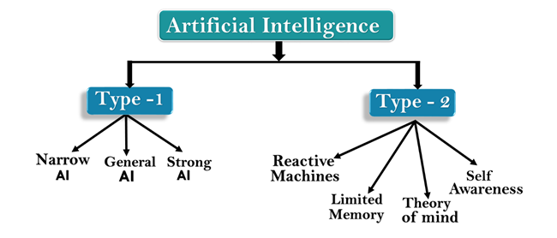
Types of Artificial Intelligence:
Artificial Intelligence can be divided in various types, there are mainly two types of main categorization which are based on capabilities and based on functionally of AI. Following is flow diagram which explain the types of AI.

Slide 16
AI type-1: Based on Capabilities
Weak AI or Narrow AI:
Narrow AI is a type of AI which is able to perform a dedicated task with intelligence.The most common and currently available AI is Narrow AI in the world of Artificial Intelligence.
Narrow AI cannot perform beyond its field or limitations, as it is only trained for one specific task. Hence it is also termed as weak AI. Narrow AI can fail in unpredictable ways if it goes beyond its limits.
Apple Siriis a good example of Narrow AI, but it operates with a limited pre-defined range of functions.
IBM's Watson supercomputer also comes under Narrow AI, as it uses an Expert system approach combined with Machine learning and natural language processing.
Some Examples of Narrow AI are playing chess, purchasing suggestions on e-commerce site, self-driving cars, speech recognition, and image recognition.

Slide 17
2. General AI:
General AI is a type of intelligence which could perform any intellectual task with efficiency like a human.
The idea behind the general AI to make such a system which could be smarter and think like a human by its own.
Currently, there is no such system exist which could come under general AI and can perform any task as perfect as a human.
The worldwide researchers are now focused on developing machines with General AI.
As systems with general AI are still under research, and it will take lots of efforts and time to develop such systems.

Slide 18
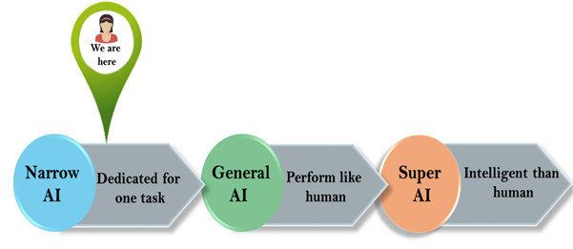
3. Super AI:
Super AI is a level of Intelligence of Systems at which machines could surpass human intelligence, and can perform any task better than human with cognitive properties. It is an outcome of general AI.
Some key characteristics of strong AI include capability include the ability to think, to reason,solve the puzzle, make judgments, plan, learn, and communicate by its own.
Super AI is still a hypothetical concept of Artificial Intelligence. Development of such systems in real is still world changing task.

Slide 19
Artificial Intelligence type-2: Based on functionality
Reactive Machines
Purely reactive machines are the most basic types of Artificial Intelligence.
Such AI systems do not store memories or past experiences for future actions.
These machines only focus on current scenarios and react on it as per possible best action.
IBM's Deep Blue system is an example of reactive machines.
Google's AlphaGo is also an example of reactive machines.
2. Limited Memory
Limited memory machines can store past experiences or some data for a short period of time.
These machines can use stored data for a limited time period only.
Self-driving cars are one of the best examples of Limited Memory systems. These cars can store recent speed of nearby cars, the distance of other cars, speed limit, and other information to navigate the road.

Slide 20
ALGORITHMS IN AI

Slide 21
Hill Climbing Algorithm in Artificial Intelligence:
Hill climbing algorithm is a local search algorithm which continuously moves in the direction of increasing elevation/value to find the peak of the mountain or best solution to the problem. It terminates when it reaches a peak value where no neighbor has a higher value.
Hill climbing algorithm is a technique which is used for optimizing the mathematical problems. One of the widely discussed examples of Hill climbing algorithm is Traveling-salesman Problem in which we need to minimize the distance traveled by the salesman.
It is also called greedy local search as it only looks to its good immediate neighbor state and not beyond that.
A node of hill climbing algorithm has two components which are state and value.
Hill Climbing is mostly used when a good heuristic is available.
In this algorithm, we don't need to maintain and handle the search tree or graph as it only keeps a single current state.

Slide 22
Features of Hill Climbing:
Following are some main features of Hill Climbing Algorithm:
Generate and Test variant: Hill Climbing is the variant of Generate and Test method. The Generate and Test method produce feedback which helps to decide which direction to move in the search space.
Greedy approach: Hill-climbing algorithm search moves in the direction which optimizes the cost.
No backtracking: It does not backtrack the search space, as it does not remember the previous states.

Slide 23
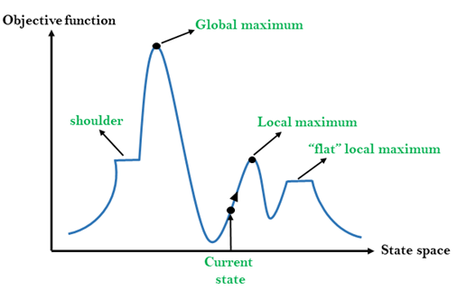
State-space Diagram for Hill Climbing:
The state-space landscape is a graphical representation of the hill-climbing algorithm which is showing a graph between various states of algorithm and Objective function/Cost.
On Y-axis we have taken the function which can be an objective function or cost function, and state-space on the x-axis. If the function on Y-axis is cost then, the goal of search is to find the global minimum and local minimum. If the function of Y-axis is Objective function, then the goal of the search is to find the global maximum and local maximum.

Slide 24
Different regions in the state space landscape:
  Local Maximum: Local maximum is a state which is better than its neighbor states, but there is also another state which is higher than it.
  Global Maximum: Global maximum is the best possible state of state space landscape. It has the highest value of objective function.
  Current state: It is a state in a landscape diagram where an agent is currently present.
  Flat local maximum: It is a flat space in the landscape where all the neighbor states of current states have the same value.
  Shoulder: It is a plateau region which has an uphill edge
Types of Hill Climbing Algorithm:
  Simple hill Climbing:
  Steepest-Ascent hill-climbing:
  Stochastic hill Climbing:

Slide 25
1. Simple Hill Climbing:
Simple hill climbing is the simplest way to implement a hill climbing algorithm. It only evaluates the neighbor node state at a time and selects the first one which optimizes current cost and set it as a current state. It only checks it's one successor state, and if it finds better than the current state, then move else be in the same state. This algorithm has the following features:
  Less time consuming
  Less optimal solution and the solution is not guaranteed
Algorithm for Simple Hill Climbing:
Step 1: Evaluate the initial state, if it is goal state then return success and Stop.
Step 2: Loop Until a solution is found or there is no new operator left to apply.
Step 3: Select and apply an operator to the current state.
Step 4: Check new state:
  If it is goal state, then return success and quit.
  Else if it is better than the current state then assign new state as a current state.
  Else if not better than the current state, then return to step2.
Step 5: Exit.

Slide 26
2. Steepest-Ascent hill climbing:
The steepest-Ascent algorithm is a variation of simple hill climbing algorithm. This algorithm examines all the neighboring nodes of the current state and selects one neighbor node which is closest to the goal state. This algorithm consumes more time as it searches for multiple neighbors
Algorithm for Steepest-Ascent hill climbing:
Step 1: Evaluate the initial state, if it is goal state then return success and stop, else make current state as initial state.
Step 2: Loop until a solution is found or the current state does not change.
  Let SUCC be a state such that any successor of the current state will be better than it.
  For each operator that applies to the current state:
    Apply the new operator and generate a new state.
    Evaluate the new state.
    If it is goal state, then return it and quit, else compare it to the SUCC.
    If it is better than SUCC, then set new state as SUCC.
    If the SUCC is better than the current state, then set current state to SUCC.
Step 3: Exit.

Slide 27
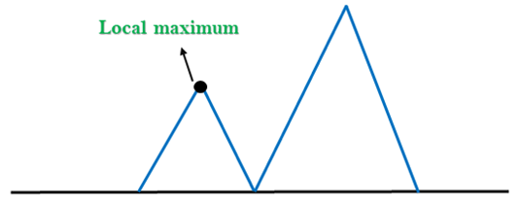
Problems in Hill Climbing Algorithm:
Local Maximum: A local maximum is a peak state in the landscape which is better than each of its neighboring states, but there is another state also present which is higher than the local maximum.
Solution: Backtracking technique can be a solution of the local maximum in state space landscape. Create a list of the promising path so that the algorithm can backtrack the search space and explore other paths as well.

Slide 28
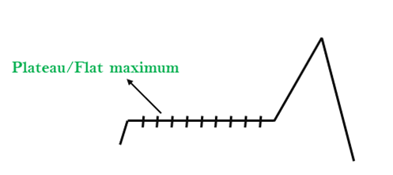
2. Plateau:
A plateau is the flat area of the search space in which all the neighbor states of the current state contains the same value, because of this algorithm does not find any best direction to move.
A hill-climbing search might be lost in the plateau area.
Solution: The solution for the plateau is to take big steps or very little steps while searching, to solve the problem. Randomly select a state which is far away from the current state so it is possible that the algorithm could find non-plateau region.

Slide 29
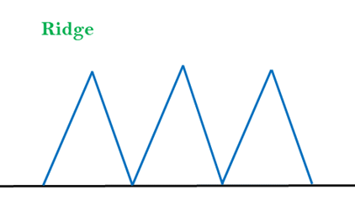
3. Ridges:
A ridge is a special form of the local maximum.
It has an area which is higher than its surrounding areas, but itself has a slope, and cannot be reached in a single move.
Solution: With the use of bidirectional search, or by moving in different directions, we can improve this problem.

Slide 30
Simulated Annealing:
A hill-climbing algorithm which never makes a move towards a lower value guaranteed to be incomplete because it can get stuck on a local maximum. And if algorithm applies a random walk, by moving a successor, then it may complete but not efficient.
Simulated Annealing is an algorithm which yields both efficiency and completeness.
In mechanical term Annealing is a process of hardening a metal or glass to a high temperature then cooling gradually, so this allows the metal to reach a low-energy crystalline state.
The same process is used in simulated annealing in which the algorithm picks a random move, instead of picking the best move. If the random move improves the state, then it follows the same path.
Otherwise, the algorithm follows the path which has a probability of less than 1 or it moves downhill and chooses another path.

Slide 31
How to Implement the Hill Climbing Algorithm in Python:
EXPLANATION : Hill climbing is a mathematical optimization algorithm, which means its purpose is to find the best solution to a problem which has a (large) number of possible solutions. Explaining the algorithm (and optimization in general) is best done using an example
PROBLEM STATEMENT :
we have a salesman who needs to visit a number of cities exactly once, after which he returns to the first city. The distances between each pair of cities are known, and we need to find the shortest route. As you can imagine, there is (often) a large number of possible solutions (routes) to a specific Travelling salesman problem; the goal is to find the best (i.e. the shortest) solution.

Slide 32
SOURCE:
Hill climbing tries to find the best solution to this problem by starting out with a random solution, and then generate neighbours: solutions that only slightly differ from the current one. If the best of those neighbours is better (i.e. shorter) than the current one, it replaces the current solution with this better solution. It then repeats the pattern by again creating neighbours. If at some point no neighbour is better than the current solution, it returns the then current solution. That’s it! The algorithm is quite simple, but it needs to be said that it doesn’t always find the best solution. It can get stuck in a local maximum: a place where the current solution isn’t the best solution to the problem, but where none of the direct neighbours of the current solution are better than the current solution. As described, the algorithm will stop at such a point, unfortunately without returning the best solution. More complicated algorithms exist that have a higher chance of finding the best solution, but they often take more computational resources.
Anyway, let’s start coding the Travelling salesman problem and Hill climbing in Python!

Slide 33
Create a Travelling salesman problem:
First, let’s code an instantiation of the Travelling salesman problem. If you think about it, such an instantiation should be a list of cities, where each one has information about the distances from there to the other cities.
Of course, the distance from each city to itself is zero, and the distance from city A to city B is the same as the distance from city B to city A.
That gives us a list, containing n lists of size n (where in this case n equals 4)
  tsp = [
  [0, 400, 500, 300],
  [400, 0, 300, 500],
  [500, 300, 0, 400],
  [300, 500, 400, 0]
  ]
As we can see, the first city’s distance to itself is, of course, 0, and, for example, its distance to the third city is 500. One can see that the third city’s distance to the first is also 500 (the first entry of the third array), as it should.

Slide 34
Create a random solution generator:
For Hill climbing to work, it has to start with a random solution to our Travelling salesman problem. From there, it can generate neighbouring solutions and start the optimization process. How should we design such a solution? Well, a solution to the Travelling salesman problem could simply be a list of identifiers of all cities, in the order the salesman should visit them. Each city has to be visited exactly once.
Let’s therefore first create a list of identifiers of all cities and from there on iteratively pick a city from that list at random and add it to our solution. Python’s range function is excellent for creating cities, as it creates a range of all numbers from 0 to the argument given, which in this case is the length of the problem itself, as the problem itself contains one entry for each city.
Since every city can only be visited one, after its identifier is added to our solution we then remove that city’s identifier from the city identifier list. Our function needs the Travelling salesman problem itself for information about the distances between cities. See the code below (note that you will need to import random for this to work):

Slide 35
  def randomSolution(tsp):
  cities = list(range(len(tsp)))
  solution = []
  for i in range(len(tsp)):
  randomCity = cities[random.randint(0, len(cities) - 1)]
  solution.append(randomCity)
  cities.remove(randomCity)
  return solution

Slide 36
Create a function calculating the length of a route:
Since we want our Hill climber to find the shortest solution, we need a function calculating the length of a specific solution. This function needs the Travelling salesman problem itself (for information about the distances between cities) and of course the solution of which we need the route length.
Since a solution is a list of all cities in a specific order, we can just iterate over a solution and use the tsp argument to add the distance to each new city to our total route length.
The iterator i “visits” each city, so i-1 is “at” the previous city or the last city when i equals 0 (which is exactly what we want, since we want to end up at the first city again).
solution[i] thus gives us the current city, and solution[i-1] gives us the previous one. Then we simply use the tsp to get the distance between these cities, which we add to the total length of the route (routeLength).

Slide 37
  def routeLength(tsp, solution):
  routeLength = 0
  for i in range(len(solution)):
  routeLength += tsp[solution[i - 1]][solution[i]]
  return routeLength

Slide 38
Create a function generating all neighbours of a solution:
As explained before, Hill climbing works in part by generating all neighbouring solutions to the current solution. Let’s create a function doing exactly that.
A neighbouring solution is a solution that’s only slightly different from the current solution. Note also that a neighbour still needs to be a correct solution: every city still needs to be visited exactly once. We can accomplish both by creating a neighbour as follows: copy the current solution, and then make two cities swap places! This way, we create a slightly different solution that’s still correct.
Since we want to create all neighbours to a solution, and need to make cities swap places, we need to create two for loops, one nested in the other, both iterating the current solution.
Since swapping city A with city B is the same as swapping city B with city A, our second loop needs to only loop over those cities the first loop hasn’t looped over yet. Inside the second loop, we create our neighbour with the swapped cities and add it to our neighbours list.

Slide 39
  def getNeighbours(solution):
  neighbours = []
  for i in range(len(solution)):
  for j in range(i + 1, len(solution)):
  neighbour = solution.copy()
  neighbour[i] = solution[j]
  neighbour[j] = solution[i]
  neighbours.append(neighbour)
  return neighbours

Slide 40
Create a function finding the best neighbour:
Now that we have a function generating all neighbours to a solution, it’s time we create one finding the best of these neighbours. This is a pretty straightforward function: it first sets the bestNeighbour to the first neighbour in the list of neighbours (and bestRouteLength to its route length), and then iterates over all neighbours; when a neighbour has a shorter route length, both bestNeighbour and bestRouteLength are updated.
This way, the best neighbour is found:
  def getBestNeighbour(tsp, neighbours):
  bestRouteLength = routeLength(tsp, neighbours[0])
  bestNeighbour = neighbours[0]
  for neighbour in neighbours:
  currentRouteLength = routeLength(tsp, neighbour)
  if currentRouteLength < bestRouteLength:
  bestRouteLength = currentRouteLength
  bestNeighbour = neighbour
  return bestNeighbour, bestRouteLength

Slide 41
Create the Hill climbing algorithm:
It’s time for the core function! After creating the previous functions, this step has become quite easy:
  def hillClimbing(tsp):
  currentSolution = randomSolution(tsp)
  currentRouteLength = routeLength(tsp, currentSolution)
  neighbours = getNeighbours(currentSolution)
  bestNeighbour, bestNeighbourRouteLength = getBestNeighbour(tsp, neighbours)
  while bestNeighbourRouteLength < currentRouteLength:
  currentSolution = bestNeighbour
  currentRouteLength = bestNeighbourRouteLength
  neighbours = getNeighbours(currentSolution)
  bestNeighbour, bestNeighbourRouteLength = getBestNeighbour(tsp, neighbours)
  return currentSolution, currentRouteLength

Slide 42
INSIGHTS:
First, we make a random solution and calculate its route length.
We then create the neighbouring solutions, and find the best one.
From there on, as long as the best neighbour is better than the current solution, we repeat the same pattern with the current solution each time being updated with the best neighbour.
When this process stops, we return the current solution (and its route length).

Slide 43
Mini-Max Algorithm in Artificial Intelligence:
Mini-max algorithm is a recursive or backtracking algorithm which is used in decision-making and game theory. It provides an optimal move for the player assuming that opponent is also playing optimally.
Mini-Max algorithm uses recursion to search through the game-tree.
Min-Max algorithm is mostly used for game playing in AI. Such as Chess, Checkers, tic-tac-toe, go, and various tow-players game. This Algorithm computes the minimax decision for the current state.
In this algorithm two players play the game, one is called MAX and other is called MIN.
Both the players fight it as the opponent player gets the minimum benefit while they get the maximum benefit.
Both Players of the game are opponent of each other, where MAX will select the maximized value and MIN will select the minimized value.
The minimax algorithm performs a depth-first search algorithm for the exploration of the complete game tree.
The minimax algorithm proceeds all the way down to the terminal node of the tree, then backtrack the tree as the recursion.

Slide 44
Pseudo-code for MinMax Algorithm:
  function minimax(node, depth, maximizingPlayer) is
  if depth ==0 or node is a terminal node then
  return static evaluation of node
  if MaximizingPlayer then // for Maximizer Player
  maxEva= -infinity
  for each child of node do
  eva= minimax(child, depth-1, false)
  maxEva= max(maxEva,eva) //gives Maximum of the values
  return maxEva
  else: // for Minimizer player
  minEva= +infinity
  for each child of node do
  eva= minimax(child, depth-1, true)
  minEva= min(minEva, eva) //gives minimum of the values
  return minEva
Initial call:
Minimax(node, 3, true)

Slide 45
Working of Min-Max Algorithm:
The working of the minimax algorithm can be easily described using an example. Below we have taken an example of game-tree which is representing the two-player game.
In this example, there are two players one is called Maximizer and other is called Minimizer.
Maximizer will try to get the Maximum possible score, and Minimizer will try to get the minimum possible score.
This algorithm applies DFS, so in this game-tree, we have to go all the way through the leaves to reach the terminal nodes.
At the terminal node, the terminal values are given so we will compare those value and backtrack the tree until the initial state occurs. Following are the main steps involved in solving the two-player game tree

Slide 46
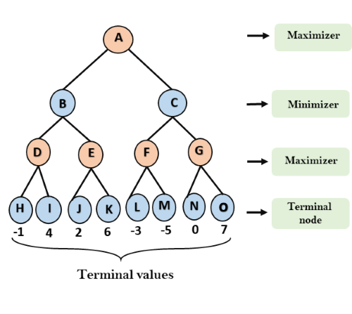
Step-1: In the first step, the algorithm generates the entire game-tree and apply the utility function to get the utility values for the terminal states. In the below tree diagram, let's take A is the initial state of the tree. Suppose maximizer takes first turn which has worst-case initial value =- infinity, and minimizer will take next turn which has worst-case initial value = +infinity.

Slide 47
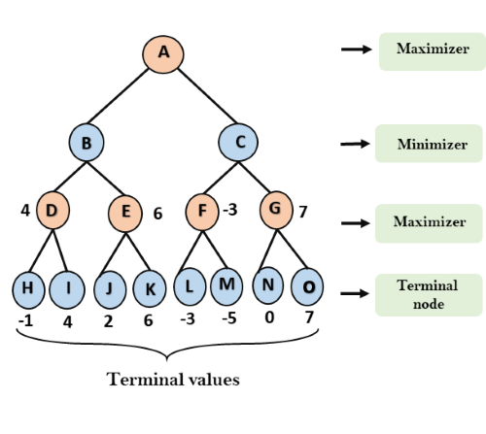
Step 2: Now, first we find the utilities value for the Maximizer, its initial value is -∞, so we will compare each value in terminal state with initial value of Maximizer and determines the higher nodes values. It will find the maximum among the all.
For node D max(-1,- -∞) => max(-1,4)= 4
For Node E max(2, -∞) => max(2, 6)= 6
For Node F max(-3, -∞) => max(-3,-5) = -3
For node G max(0, -∞) = max(0, 7) = 7

Slide 48
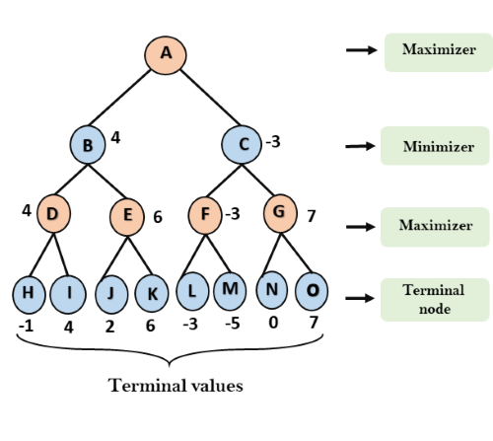
Step 3: In the next step, it's a turn for minimizer, so it will compare all nodes value with +∞, and will find the 3rd layer node values.
  For node B= min(4,6) = 4
  For node C= min (-3, 7) = -3

Slide 49
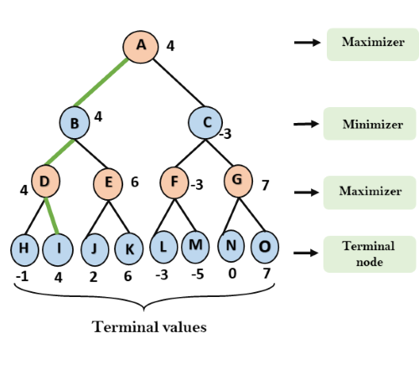
Step 4: Now it's a turn for Maximizer, and it will again choose the maximum of all nodes value and find the maximum value for the root node. In this game tree, there are only 4 layers, hence we reach immediately to the root node, but in real games, there will be more than 4 layers.
  For node A max(4, -3)= 4
That was the complete workflow of the minimax two player game

Slide 50
Properties of Mini-Max algorithm:
Complete- Min-Max algorithm is Complete. It will definitely find a solution (if exist), in the finite search tree.
Optimal- Min-Max algorithm is optimal if both opponents are playing optimally.
Time complexity- As it performs DFS for the game-tree, so the time complexity of Min-Max algorithm is O(b^{m}), where b is branching factor of the game-tree, and m is the maximum depth of the tree.
Space Complexity- Space complexity of Mini-max algorithm is also similar to DFS which is O(bm).
Limitation of the minimax Algorithm:
The main drawback of the minimax algorithm is that it gets really slow for complex games such as Chess, go, etc.
This type of games has a huge branching factor, and the player has lots of choices to decide.
This limitation of the minimax algorithm can be improved from alpha-beta pruning which we have discussed in the next topic.

Slide 51
THE END

